Slide 1
Exploratory Data Analysis

Slide 2
Exploratory Data Analysis
Analyze data sets to summarize their characteristics
Numerical summarization
Data visualization

Slide 3
Exploratory Data Analysis
Gives us an overall view
Helps avoid oversight
Helps recognize “oddballs”
May help decide next steps

Slide 4
Data Types
Categorical (Qualitative)
Data that can be classified into categories
Nominal or Ordinal
Numerical (Quantitative)
Data that can be counted or measured
Discrete or Continuous

Slide 5
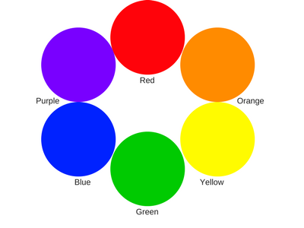
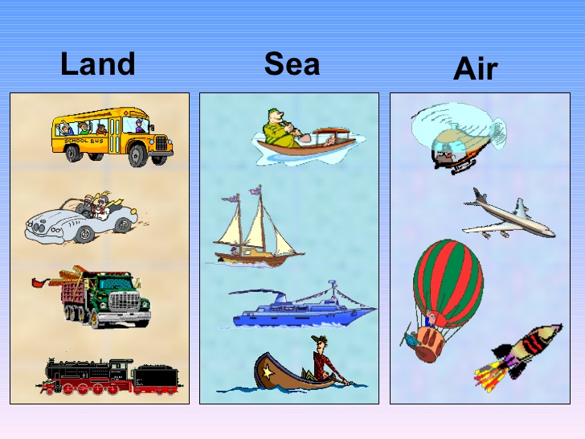

Categorical Data - Nominal
Data that is labeled without a numerical value
No order involved with the labels

Slide 6

Categorical Data - Ordinal
Data that is labeled into categories with order
Can be a number but numbers are not a measure
Ex. Evaluation scale (1-5), spiciness, etc.

Slide 7

Numerical Data - Discrete
Round, discrete numbers that can be counted
Data with finite number of values
Ex. # of students, # of pets, etc.

Slide 8

Numerical Data - Continuous
Numerical data that is measurable
Data that can take on infinite values
Ex. Height, temperature, etc.

Slide 9
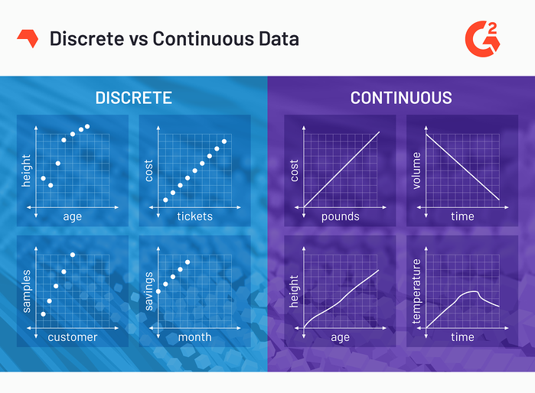

Slide 10
Nominal, Ordinal, Discrete, or Continuous?
Year of birth Weight Company size Strength of coffee Favorite sport Time to get to work

Slide 11
Data Type vs. Measures of Central Tendency
 | Nominal | Ordinal | Discrete | Continuous
Mode | x | x | x | x
Median |  | x | x | x
Mean |  |  | x | x

Slide 12

Data Visualization
Graphical display of data
Can convey trends and anomalies more efficiently

Slide 13
Data Visualization
Univariate Exploration
Explore one variable of a data set
Bar chart
Histogram
Box plot

Slide 14

Bar Charts
For data organized categorically
Compares different groups
Category vs. Measured Value

Slide 15
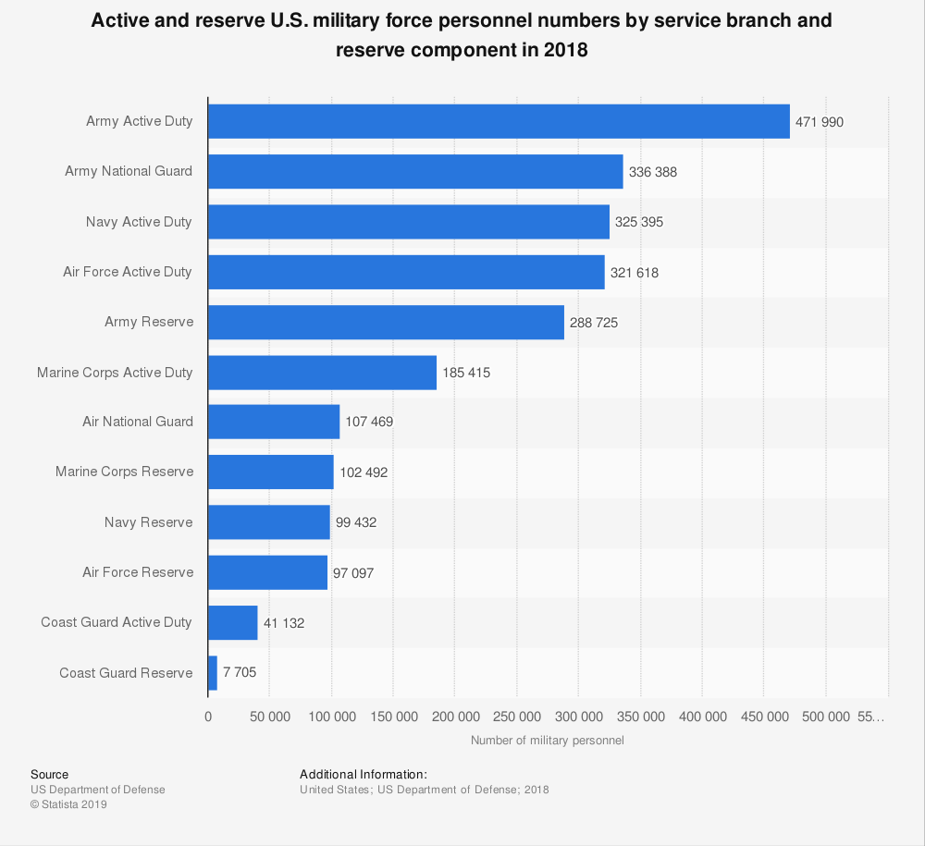

Slide 16
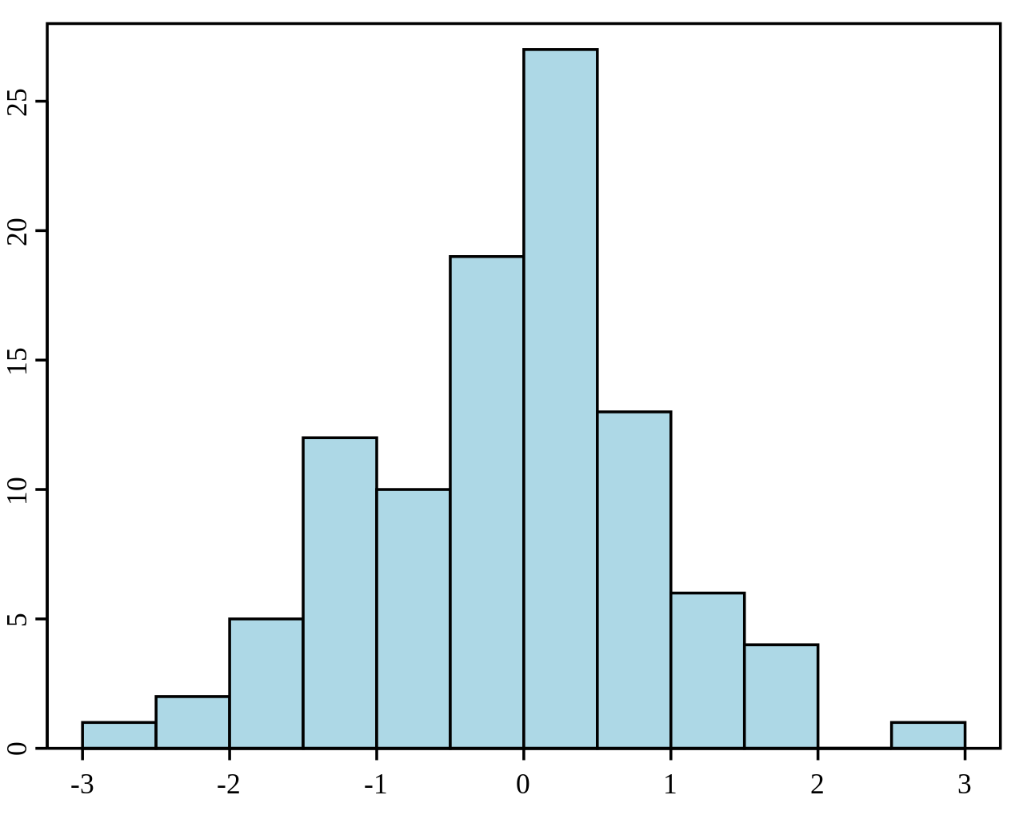
Histograms
For data organized numerically
Most used for continuous data
Uses “bins” (range of values) to group

Slide 17
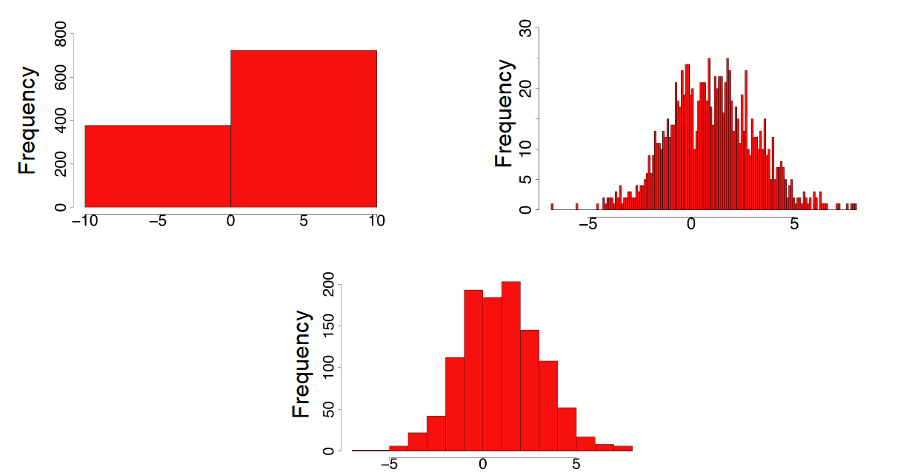
Effect of Bin Size

Slide 18
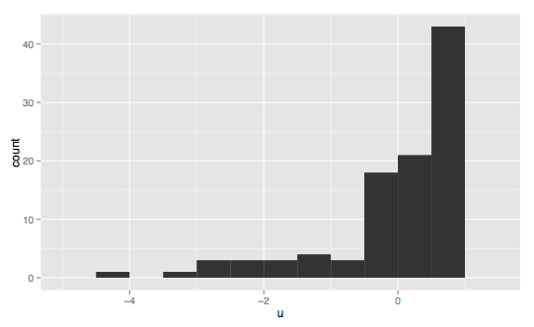
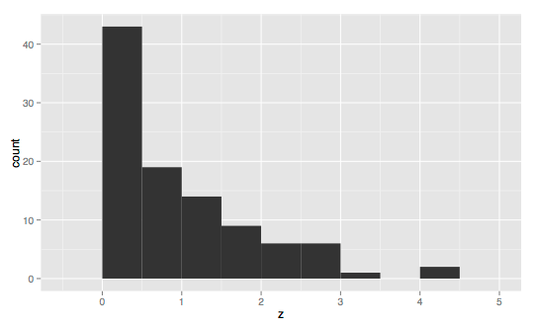
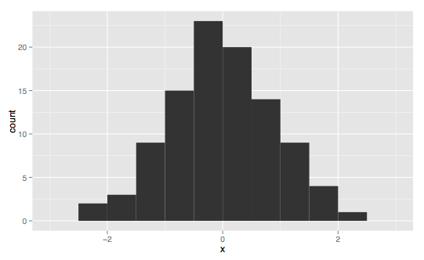
Skewness with Histogram

Slide 19
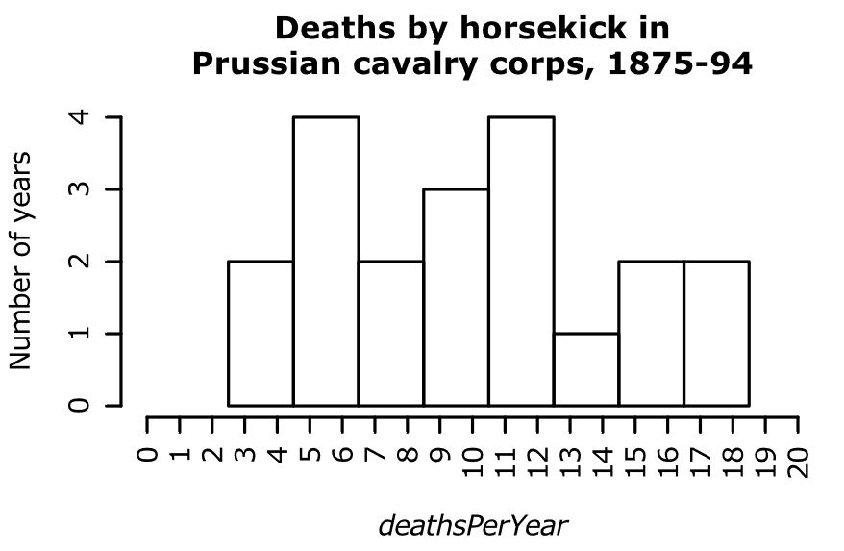

Slide 20
Bar Chart or Histogram?
Favorite fruits Number of people per class Number of people per age group Instructor evaluations (5-point scale) Number of trees per height

Slide 21
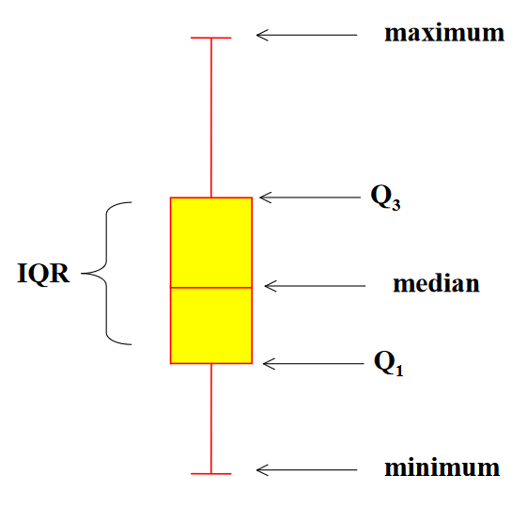
Box Plots
5-number summary
Display data by quartiles
Highlights spread of data

Slide 22
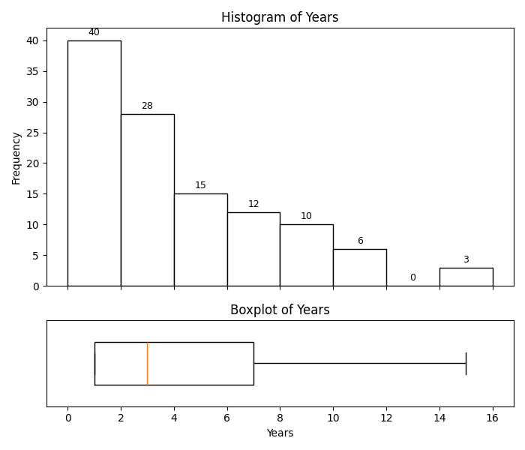

Slide 23

Why visualization?
90% of information transmitted to the brain is visual
Human brains process visuals 60,000 times faster than text

Slide 24
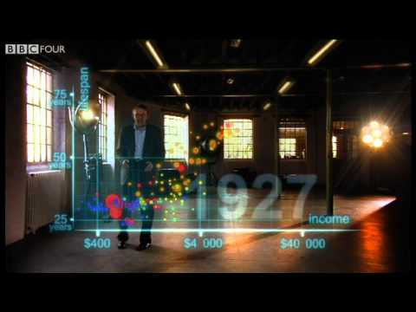
Visualization Techniques

